Slide 1
Object Oriented Programming with C++
Object oriented programming
Spring 2024
Lecture - 12

Slide 2
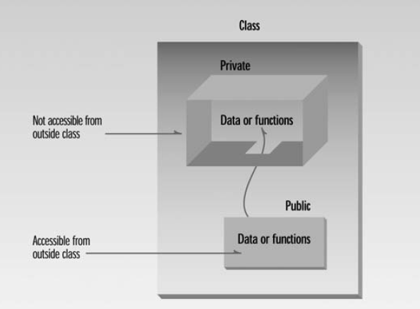
C++ Classes

Slide 3
Class Rectangle
#include<iostream>
Using namespace std;
class Rectangle
{
int length;
int width;
public:
void setValues(int, int);
void printValues();
int CalcArea();
}
void Rectangle::setValues(int x, int y)
{length=x;
width=y; }
void Rectangle::printValues()
{cout<<“length=“<<length<<endl;
cout<<“width=“<<width;}
int Rectangle::CalcArea()
{return (length*width);}
width
length

Slide 4
Class Rectangle
#include<iostream>
Using namespace std;
class Rectangle
{
int length;
int width;
public:
void setValues(int, int);
void printValues();
int CalcArea();
}
void Rectangle::setValues(int x, int y)
{length=x;
width=y; }
void Rectangle::printValues()
{cout<<“length=“<<length<<endl;
cout<<“width=“<<width;}
int Rectangle::CalcArea()
{return (length*width);}
width
length
Scope resolution operator
General
Function implementation.

Slide 5
Declaring an object
void main()
{
Rectangle R1;
}
length
junk
width
junk
R1

Slide 6
Rectangle R1;
R1.setValues(2,3);
Function call for R1
x=2, y=3
void Rectangle::setValues(int x, int y)
{
length=x;
width=y; }
result
length
2
width
3
R1

Slide 7
Rectangle R1;
R1.setValues(2,3);
R1.printValues();
length
2
width
3
call for R1
R1
void Rectangle::printValues()
{cout<<“length=“<<length<<endl;
cout<<“width=“<<width;}
output:
length=2
width=3

Slide 8
Rectangle R1;
R1.setValues(2,3);
R1.printValues();
cout<<R1.CalcArea();
length
2
width
3
call for R1
R1
int Rectangle::CalcArea()
{return (length*width);}
Output
6

Slide 9
Object as member function parameter
bool Rectangle::compare(Rectangle temp)
{
if (length==temp.length && width==temp.width)
return true;
else return false;
}

Slide 10
Returning object from a function
Rectangle Rectangle::Add(Rectange temp)
{Rectangle sum;
sum.length=length+temp.length
sum.width=width+temp.width)
return sum;
}

Slide 11
Objects as non-member function parameter
We want to implement a non-member function for class that calculates a parameter (sum of sides) of a rectangle passed as an parameter
int CalcParameter(Rectangle r);
Pseudo Code:
int CalcParameter(Rectangle r)
{
return (r.length+r.width);
}
Is it allowed?

Slide 12
Correct Implementation
int Rectangle::getLength() {return length;}
int Rectangle::getWidth()
{return widht;}
int CalcParameter(Rectangle r)
{
return (2*(r.getLength()+r.getWidth()));
}
member functions of class Rectangle
Functional CALL:
void main()
{
Rectangle r1;
r1.setValues(1,2);
cout<<CalcParameter(r1);
}

Slide 13
int CalcParameter(const Rectangle &r)
{
return (2*(r.getLength()+r.getWidth()));
}
To save memory
We don’t want this function to change value of r

Slide 14
Accessor and Mutator Functions
Accessor Function: A member function of a class that only access (does not modify) the values of the member variables
Example:
void printValues();
int getLength();
int getWidth();
We typically add reserved word “const” at the end of the heading of these functions. Such functions are then called constant member functions.
Constant member functions cannot modify the member variables of that class.
e.g.,
void printValues()const;
Mutator Function: A member function of a class that modifies the value(s) of the member variable(s)
e.g.,
void setValues(int x, int y);

Slide 15
Initializing Objects
What is the output of following code:
void main()
{
Rectangle R1;
R1.printValues();
}
We need to initialize objects
We cannot do this:
class Rectangle
{int length=1;
int width=1;
public:
…
}

Slide 16
Constructor
Special kind of member function used for initializing an object
It has a same name as the class itself
It has no return type (not even void)
It is invoked automatically when an object is created
It may have arguments
Constructor cannot be called like other functions
Syntax:
className(parameters [optional]);

Slide 17
Constructor: Example
Constructor is called automatically when object is created
class Rectangle
{
int length;
int width;
public:
Rectangle();
…}
Rectangle::Rectangle()
{
length=1;
width=1;
}
void main()
{
Rectangle R1;
R1.printValues();
}
We cannot do this to call constructor:
R1.Rectangle();
Output:
length=1
width=1

Slide 18
Types of Constructors
Default constructor
Parameterized Constructor
Copy Constructor

Slide 19
Default constructor
It does not have any parameters
If no user defined constructor exists for a class, C++ compiler generates a default constructor
Example:
class Rectangle
{
int length;
int width;
public:
Rectangle(); //default made by user
…}
Rectangle::Rectangle()
{
length=1;
width=1;
}
void main()
{
Rectangle R1;
R1.printValues();
}

